Slide 1






Hello Strings Methods
PRESENTED BY:
Darie “007” Dorlus
Chief Happiness Officer
darie@bocacode.com

Slide 2
Pop Quiz?
What’s a String?

Slide 3
Nope, you are NOT wrong!

Slide 4
A String
Strings are useful for holding data that can be represented in text form

Slide 5
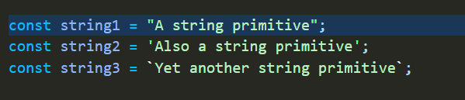
Strings

Slide 6
Common String Methods

Slide 7
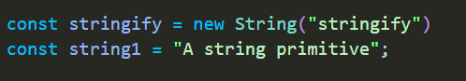
new String(“mango”)
creates a new string

Slide 8
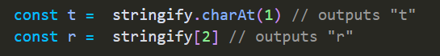
.charAt(1)
Returns the character at the provided index

Slide 9
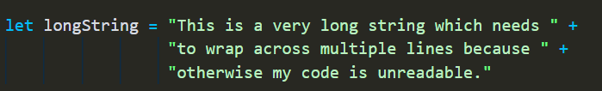
concatenation | string + string
Adding multiple strings together

Slide 10
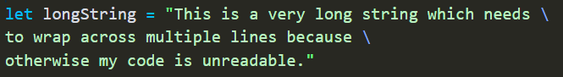
Long literal strings | with \

Slide 11
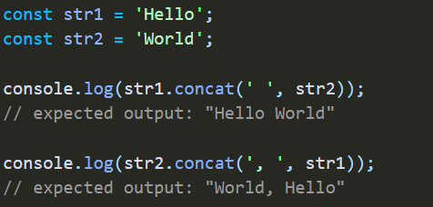
.concat(string, string, …)
Adding multiple strings together

Slide 12
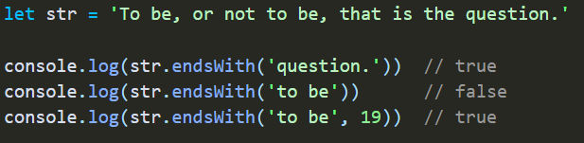
.endsWith(str, [endPos)
Returns true if the string ends with str
Or false otherwise

Slide 13
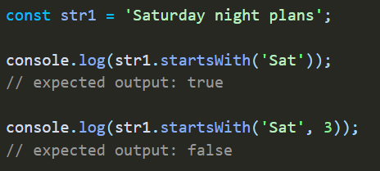
.startsWith(str, [startPos)
Returns true if the string begins with str
Or false otherwise

Slide 14
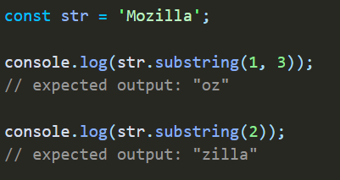
.substring(startInd, [endPos)
Returns a new string with starting a “startInd” and ending at endPos - 1

Slide 15
.includes(“kiwi”)

Slide 16
.indexOf(“peach”)
Returns the index of the 1st occurrence of the element or -1 if not found

Slide 17
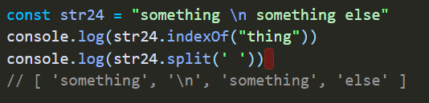
.split(separator)
Turns strings in to arrays

Slide 18
.replace(target, replacement )
Replace the first occurrence of target

Slide 19
.replaceAll(target, replacement )
Replace all the occurrence of target

Slide 20
Others..
toLowerCase()
toUppperCase()
trim()

Slide 21
.foreach(function(val, i, arr){ })
Combines 2 or more arrays
Returns a completely new array

Slide 22
Part 2

Slide 23
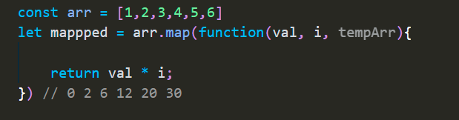
.map(function(val, i, arrr){})
Returns new array with results of function

Slide 24
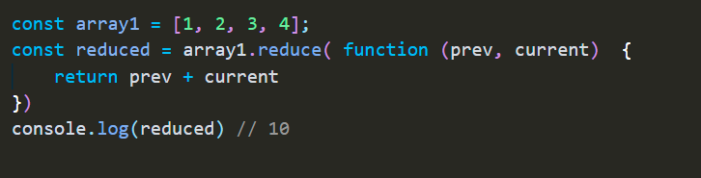
.reduce( function(prev, current ){} )
Apply the callback function on every element returning a single value

Slide 25
.sort(function(first, second){ })
Sorts an array in place
Sorts in ascending or by default

Slide 26
Thank You.

